Slide 1
CS 3377 & SCI 3377 Major Assignment
Change Notice 0002 - Major Assignment - Project High Rise
Disruption to your project – (And it’s a big one….)

Slide 2
Oh no! The locations of the foundations got mixed up out on site! The City approved location of version 1 where version 2 has been built, and version 2 where version 1 has been built! This needs to be corrected. That will mean coming up with a plan to turn building 1 into building 2 without starting from scratch, and turning building 2 into building 1, without starting from scratch. It will take some real thought. There is some demolition involved for sure, but we cannot just start again. That is too expensive and will ruin too much completed work. First figure out what can stay, and what must go. Good luck!
Students:
If you were the PM on a version 1 building so far this semester, in phase 4 you have to quote turning it into the version 2 building – not a trivial task. Then in phase 5 you will need to make these renovations.
Similarly, if you were the PM on a version 2 building so far this semester, in phase 4 you have to quote turning it into the version 1 building – not a trivial task. Then in phase 5 you will need to make these renovations.

Slide 3
Specifications for Version 1:
Specs:
7 apartments (6 tiny studio and 1 small one bedroom);
9 restaurants (8 small and 1 medium);
19 offices;
4 stores;
3 common areas;
8 stories;
2 stories lobby;
Elevator in all upper levels,
Emergency stare case;
Water and electricity for all levels;
Revenue +500/day;
Al least 4 recycling bins;
Apartment building in the upper floors;
Stores in the lower floors;
This version 1 is now the building of record for students N to Z in phases 4 and 5.
Your building should match the design of the given building. If you happen to have empty spaces in the building fill them with such building amenities as vending machines, pay phones, etc.

Slide 4
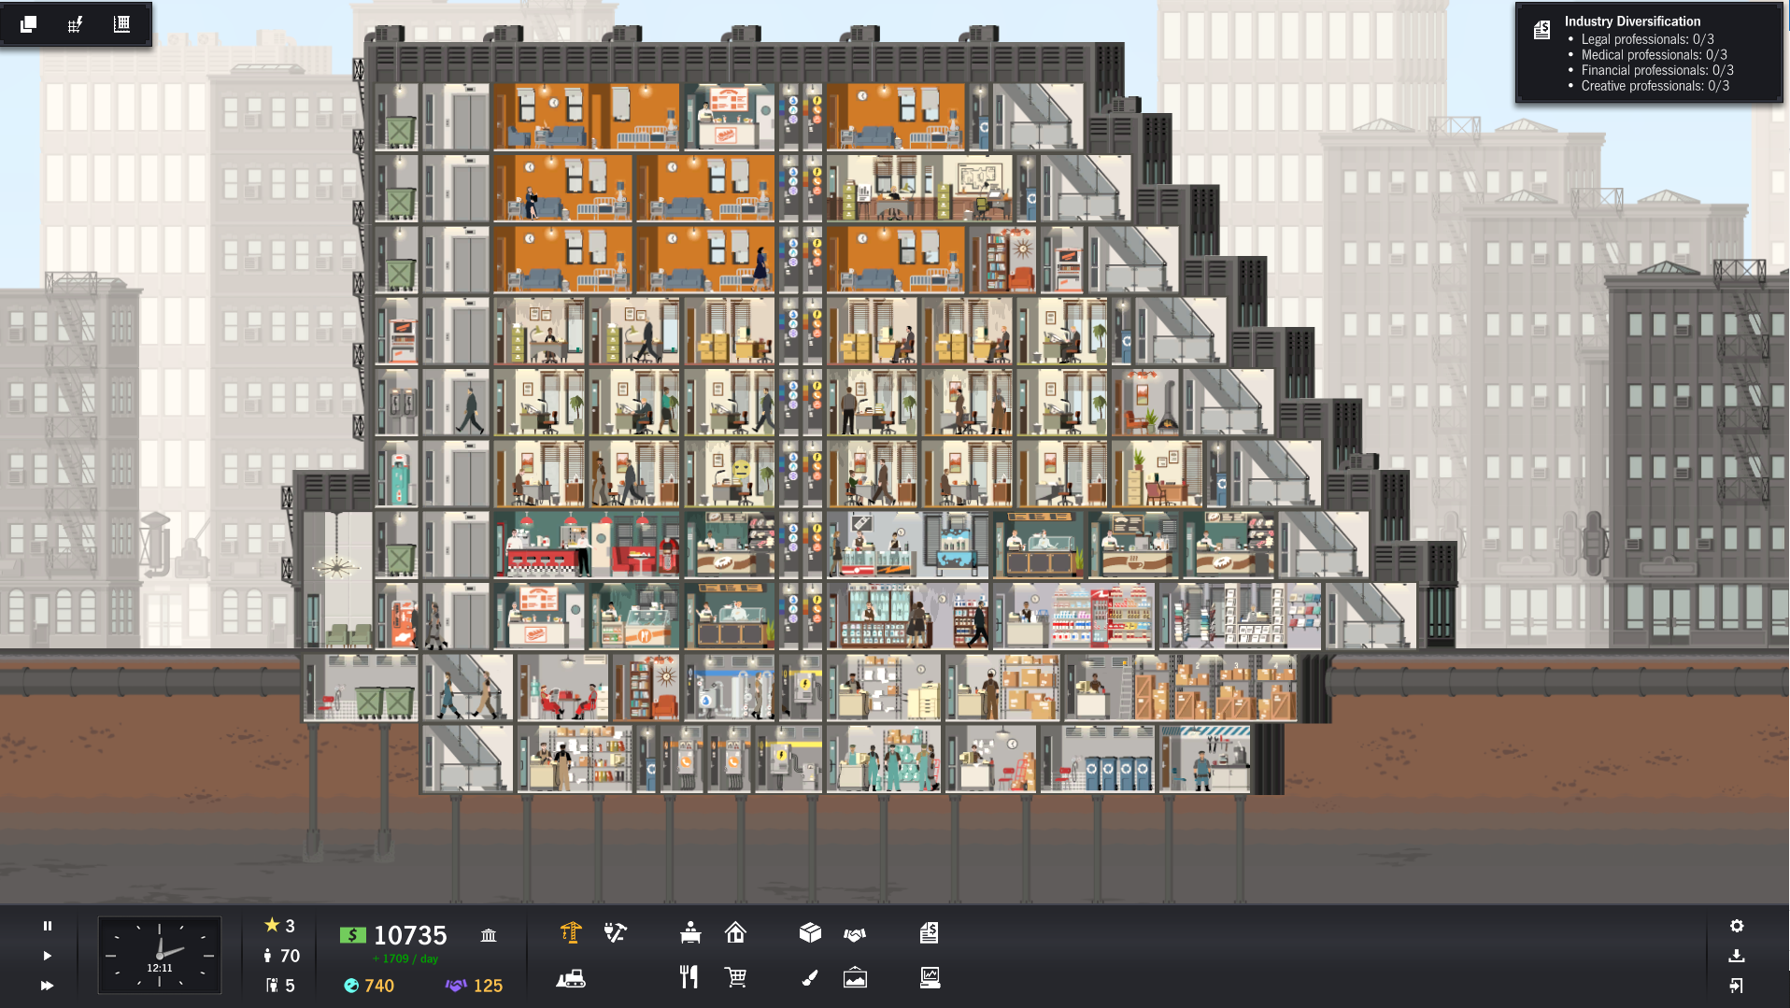
Version 1

Slide 5
Main facilities:
Apartments;
Restaurants;
Offices;
Stores;
Common areas;
Recycling bins;
Amenities – payphones, wending machines, shoe polishing
Plumbing and wiring closets
Garbage bins
Supporting services and amenities:
Garbage collection point;
Construction office;
Water meter;
Electrical transformer;
Phone switchboard;
Bottled water;
Copy Center;
Courier;
Store Room;
Recycling room;
Maintainers room;
Movers Office;
Office supplies.
Lobby
1.
2.
7.
8.
9.
.
3.
4.
13.
5.
5.
4.
6.
12.
10.
11.

Slide 6
Specifications for Version 2:
7 apartments (6 tiny studio and 1 small one bedroom);
At least 4 restaurants (1 must be medium);
19 offices;
4 stores;
At least 2 common areas;
8 stories;
2 stories lobby;
Elevators in all above ground levels,
Emergency stair case;
Water and electricity for all levels;
Revenue +500/day;
At least 2 recycling bins;
Apartment building in the upper level floors;
Stores in the lower level floors;
This version 2 is now the building of record for students A to M in phases 4 and 5.
If you happen to have empty spaces in the building fill them with such building amenities as vending machines, pay phones, etc.

Slide 7
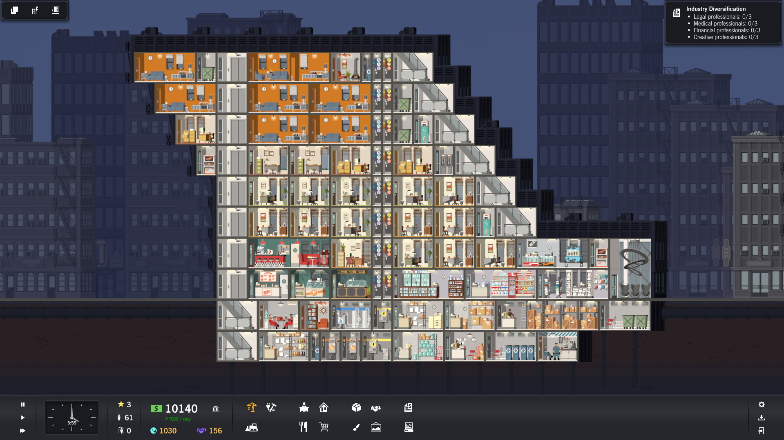
Version 2

Slide 8
Main facilities:
Apartments;
Restaurants;
Offices;
Stores;
Common areas;
Recycling bins;
Amenities – payphones, wending machines, shoe polishing
Plumbing and wiring closets
Garbage bins
Version 2
Supporting services and amenities:
Garbage collection point;
Construction office;
Water meter;
Electrical transformer;
Phone switchboard;
Bottled water;
Copy Center;
Courier;
Store Room;
Recycling room;
Maintainers room;
Movers Office;
Office supplies.
Lobby
2.
3.
4.
7.
8.
9.
1.
13.
5.
5.
4.
6.
12.
10.
11.

